Slide 1
A sentence
contains a finite verb and a subject of this verb
contains at least one main clause
1. a simple sentence
e.g. “You turn right at the crossroads.”
2. a compound sentence
e.g. “You turn right at the crossroads and then carry on for another 100 metres.”

Slide 2
3. a complex sentence
e.g. “You turn right at the crossroads and then carry on down for another 100 metres where you will find a signpost directing you to the bus station which is in Garden Square facing the post office.”
Vary your sentence structure
but not over-complicate your sentence structure!

Slide 3
Writing to Persuade

Slide 4
Writing is thinking on paper. Anyone who thinks clearly can write clearly, about anything at all.
Good English writing is clear, simple, concise, and natural.
William Zinsser (1922-2015)

Slide 5
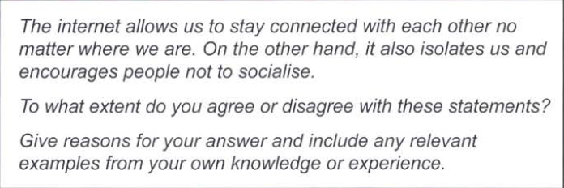

Slide 6
Step 1: decide on your own position
You must include
your own opinion about the statements
the reasons for your opinion
You can include
examples from your own personal experience. BUT these must be relevant to the question.

Slide 7
Step 2: note down any ideas about the topic
explain your own opinions on the topic
support your opinions (e.g. with personal examples or your knowledge of the world)
include only relevant ideas

Slide 8
Cross out 4 irrelevant ideas
1. Instant communication (e.g. emails, text messages) means that it is difficult to escape from work.
2. The internet makes it easier to do my homework.
3. In my company, computers have replaced many staff and have caused more unemployment.
4. A friend uses a socio-networking site a great deal but we rarely see her.
5. Virtual friends made on the internet cannot be compared to our actual friends and family.

Slide 9
6. I learnt to type using a computer programmer which made learning fun.
7. My cousin traveled for a year but kept in touch with his family every day.
8. With more and more technology, our society will continue to develop faster and faster.
9. Through the internet, we can share memories with people who are far away.

Slide 10
Step 3: organise your ideas into paragraphs
For: the internet helps us to stay connected
7. My cousin traveled for a year but kept in touch with his family every day.
9. Through the internet, we can share memories with people who are far away.
Against: the internet isolates us
1. Instant communication means that it is difficult to escape from work.
4. A friend uses a socio-networking site a great deal but we rarely see her.
5. Virtual friends made on the internet cannot be compared to our actual friends and family.

Slide 11
Don't be afraid to change the order of your points.
Don't automatically think your first ideas are the best.
Don't be afraid to spend time on planning!

Slide 12
Step 4: Structure your writing
Introduction: your opinion
Main body of explanation/ argument
Conclusion

Slide 13
Introduction
The internet is a wonderful tool that helps us to stay connected with each other no matter where we are. On the other hand, some websites encourage us not to socialise.

Slide 14
Do not copy words from the question
use a synonym of the words in the question
change the form of a word
keep in touch
anywhere in the world
however
some websites can become an obsession and may encourage people to stay at home instead of going out to see their friends.

Slide 15
After restating the question, you can
give your interpretation of the words or ideas used in the question
explain what you intend to write about
give a brief reaction to the question
I think the word “tool” is important here. In my view it shows how impersonal this contact is.
We need to consider both the benefits and the drawbacks of the internet.
These statements summarise my own mixed feelings toward the internet.

Slide 16
Linking ideas
Similarly...
that is, // namely, // in other words,
furthermore, // in addition, // apart from that, // besides,
as a result, // therefore
for instance,
in spite of // despite
Having said that,...
Concerning // Regarding //
As to how to treat the disease,...

Slide 17
Expressing a personal view
personally, / probably/ perhaps
might / could / would/ can
in my view, / as far as I am concerned,
appear to be / seem to be
Travelling is dangerous.
Travelling can be dangerous.
Most people agree with me.
I think most people would agree with me.

Slide 18
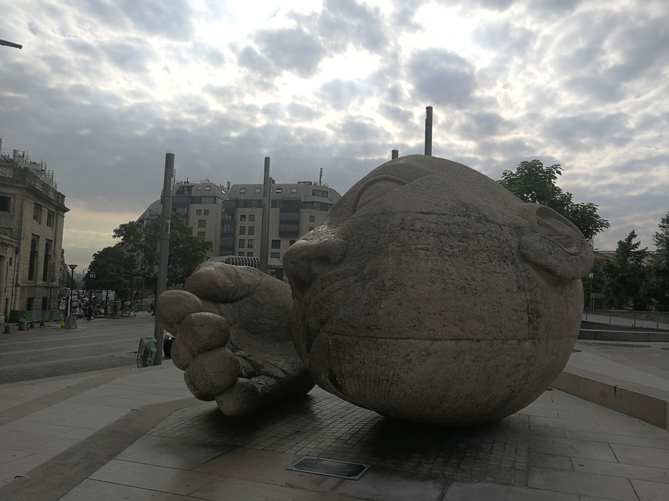
Avoid repeating “I think”
I feel...
I realise that...
I can see that...
I suppose that...
I believe that...
I am convinced that...
I imagine that...

Slide 19
Reaching a conclusion
In conclusion, there are both negatives and positives to this system, but the negatives seem to far outweigh the positives.
In my view, education is a vital part of every child's life.
To summarise,...
To sum up,...
In short,...

Slide 20
Checking
My essay has one main idea.
There is an introduction, body, and a conclusion.
Each paragraph explains only one idea with a topic sentence.
Important content is presented in simple sentences or the main clauses.
I do not repeat myself within one sentence.
People will follow my logic and understand my writing with ease.
Tenses, spelling, punctuation
Can I make my sentences more concise?

Slide 21
Recap
Which viewpoint are you going to put forward?
Make“for and against”lists.
State your chosen viewpoint simply at the beginning.
For each main point, give evidence and examples to back up your case.
Be balanced – your argument will be at its most convincing if you make points for both sides but prove that your chosen viewpoint is the better one. Use your “for and against” lists.

Slide 22
Start a new paragraph for each main point and use the rest of the paragraph to give your evidence.
Use persuasive phrases such as: “It seems clear to me that...” “The example shows/ indicates/ demonstrates that...”
Use linking phrases such as “Nevertheless, ...” “On the other hand, ...”
Finish by restating your viewpoint, perhaps saying also that, although you can see the other point of view, you are convinced that yours is the right one.
Avoid repetition

Slide 23
You should use no construction, no form of expression, and no combination of words, that you have not seen in your reading.
Ge Chuangui(葛传槼, 1906-1992), “A 'Foolish' Principle of Composition,” Hints for Learners of English.

